Slide 1
Utilizing Collaborative Filtering to Recommend Opportunities for Positive Affect in daily life
PANOTE SIRIARAYA¹ , KENTA SUZUKI²
SHINSUKE NAKAJIMA²
¹ KYOTO INSTITUTE OF TECHNOLOGY, JAPAN
² KYOTO SANGYO UNIVERSITY, JAPAN

Slide 2
DIGITAL Health INTERVENTIONS
VR/AR and Gamification in Mental Healthcare
Gamification of Mental Health Interventions
Using Virtual Reality to support Dementia Care
Tangible Interaction for Dementia and Positive Psychology
Current Challenges
Content not personally relevant enough to be meaningful
Interventions not flexible for the specific situation of users
INTELLIGENT SYSTEMS
+
+
+
INCLUSIVE HEALTHCARE
INCLUSIVE HEALTHCARE
GAME TECHNOLOGY
GAME TECHNOLOGY
SUPPORTIVE APPLICATIONS FOR MENTAL HEALTH

Slide 3
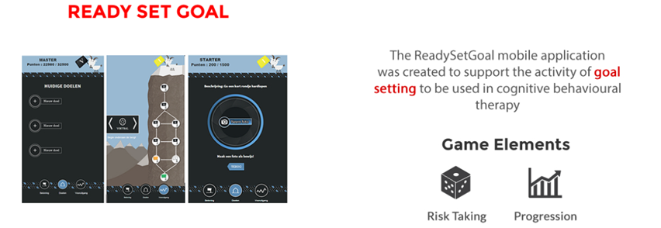
MENTAL HEALTHCARE GAMIFICATION

Slide 4
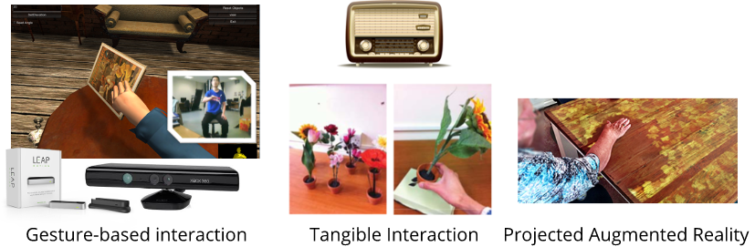
reminiscence THERAPY FOR DEMENTIA at CAREHOMES
Purpose: Reduce Problematic behaviours, Wandering
Reminiscence Therapy: People with talk and reflect back on their past experiences using artefacts such as photos, items and videos

Slide 5
RESEARCH AIMS
Develop intelligent algorithms that could be integrated into existing therapies to provide content that are relevant to the personal context of each user
Investigate how stakeholder acceptance would be effected when recommender systems are integrated with different aspects of the therapy
Provide empirical evidence regarding the effectiveness of such systems through user experiments

Slide 6
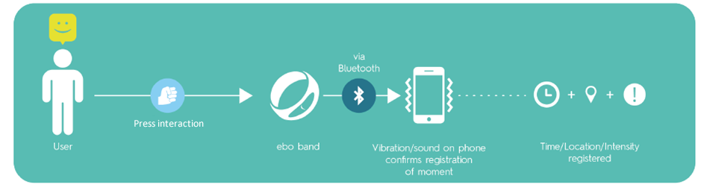
THREE GOOD THINGS APP (EBO)
Purpose: Increase Positive affect, Resilience, Reduce chance for depression
Three-good-things activity: keep a record of three things which went well for them each day which they were happy about, reflect upon those activities to experience more appreciation Target: Stressful Occupations (Police, Care-workers)

Slide 7
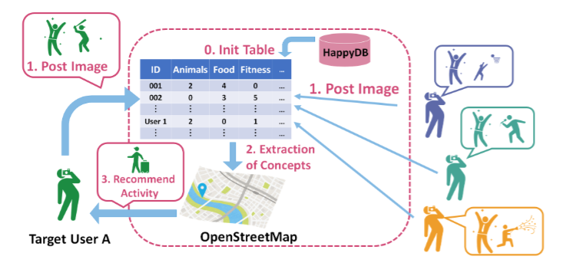
USE APP TO SUPPORT PEOPLE WITH LOW SELF-ESTEEM AND Depression
Problem with current application : Hard for people in depression and with low self esteem to find opportunities for enjoyment by themselves
Target : Incorporate An intelligent System to Recommend Opportunities for Positive Affect in daily life

Slide 8
SYSTEM DESIGN
During the day, users take a photo of satisfying life moments
After the end of each day, users write a textual description of those moments to reflect back on them
When users start to struggle to find happy moments, the recommendation system would suggest potential opportunities
Playful or social mechanisms would be employed to encourage users to look for these opportunities
Notes:
So, in the system that we are building, we would first have users<Read Text>

Slide 9
RECOMMEND OPPORTUNITIES
Exploring the use of collaborative filtering
User-Item matrix formed from “User” - ”Positive Affect Keywords”
Keywords extracted from textual descriptions of recorded instances in diary and used to fill the matrix
Data from the HappyDB was used to initialize the matrix to help avoid cold-start problem
Calculate a score for each potential keyword for each user
Notes:
Nature, Social, Physical, Intellectual

Slide 10
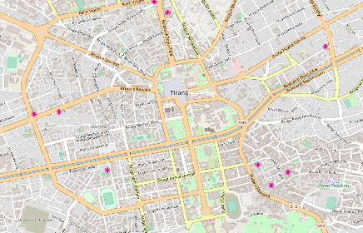


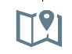




FIND NEARBY OPPORTUNITES
+
Open Street Map
Tags
Geo-tagged tweets
Keywords
Top 50 Scored Positive Affect Keywords
Averaged Word2Vec vector
X
Averaged Word2Vec vector
Pearson Correlation
List of Opportunities
Playful Treasure hunt activity
Help a friend
This Photo by Unknown Author is licensed under CC BY-SA
Notes:
-Can’t present as it is
-Need to present in a meaningful any.
-First of all, it has to be feasible, reduce effort.
-Consider the opportunities that are nearby.

Slide 11
QUESTIONS?

Slide 12
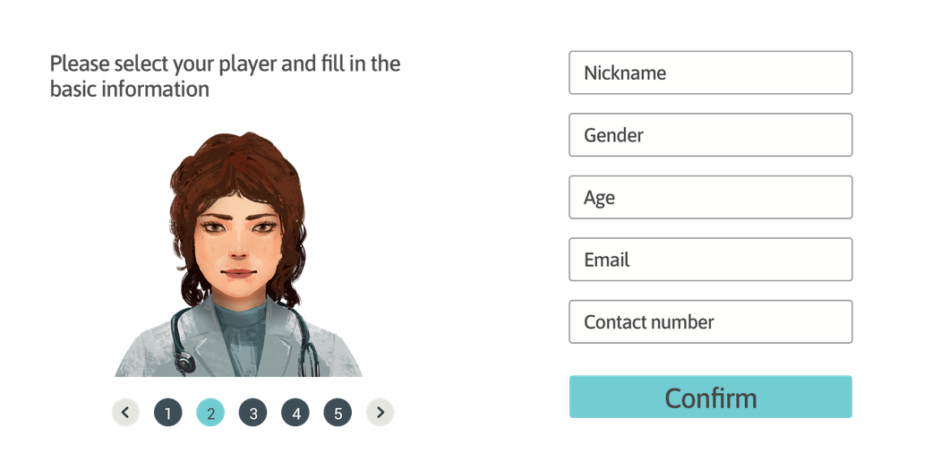
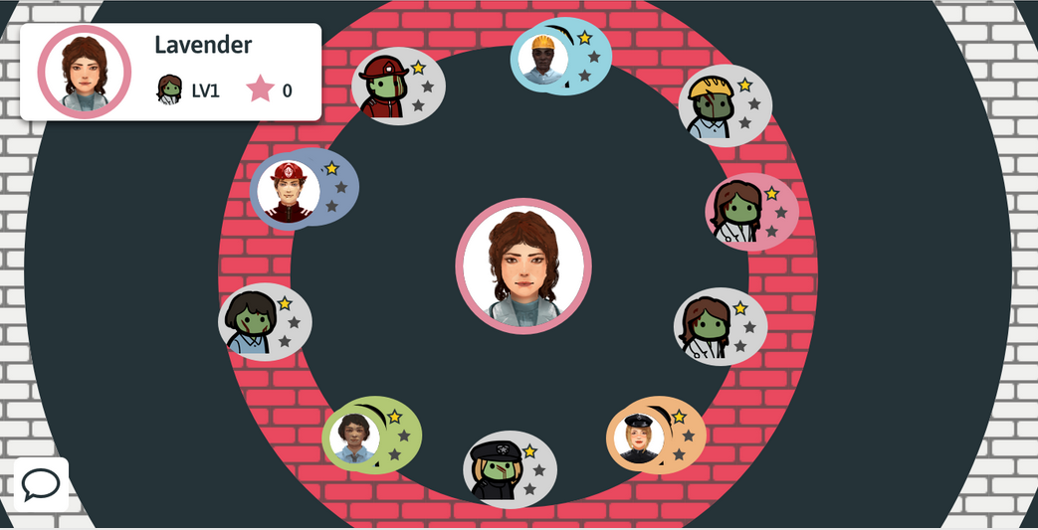
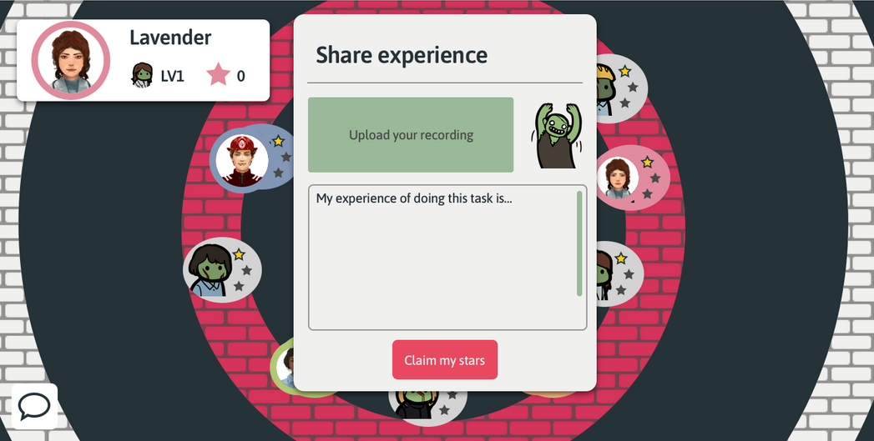
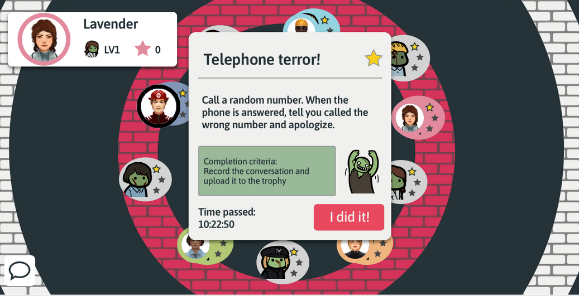
SOCIAL ANXIETY TREATMENT GAME
Purpose: Treat Social Anxiety for game addicts
Exposure Training: Let patients experience and get used to social situations

Slide 13
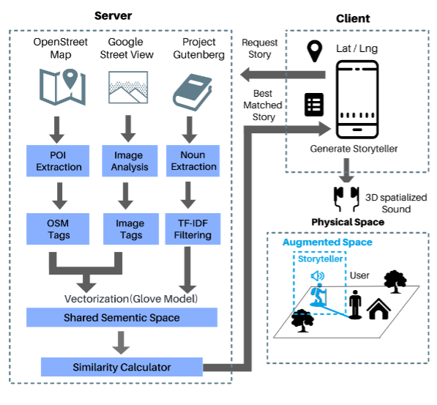
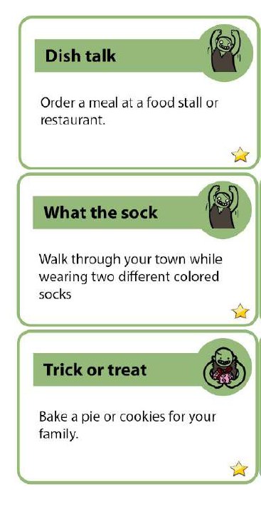
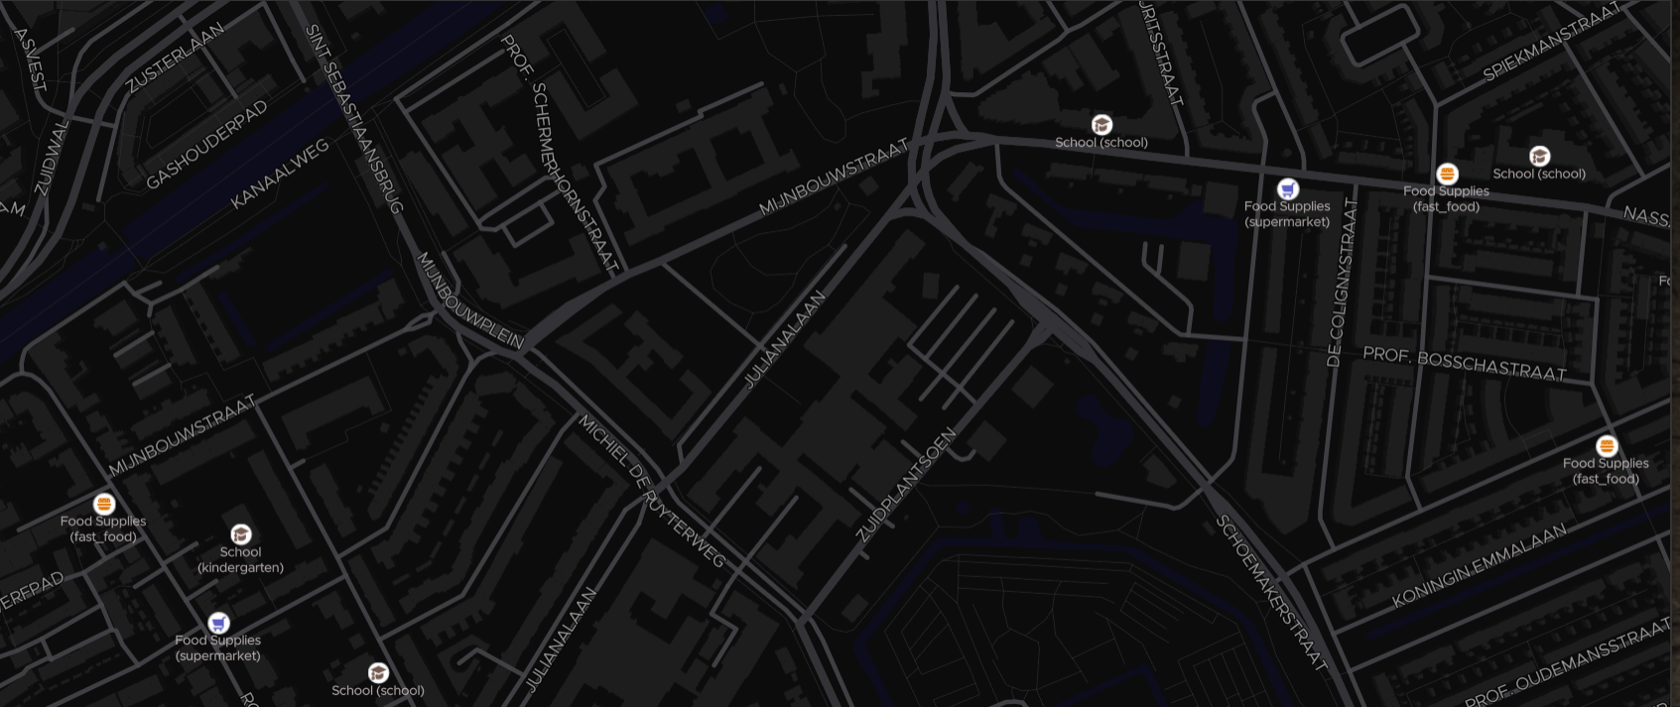






CONTEXTUALLY AWARE SOCIAL ANXIETY TREATMENT GAME
Recommend tasks which match social anxiety characteristics and contexts of users using open data
Rank tasks based on the social anxiety profile and physical location of users

Slide 14
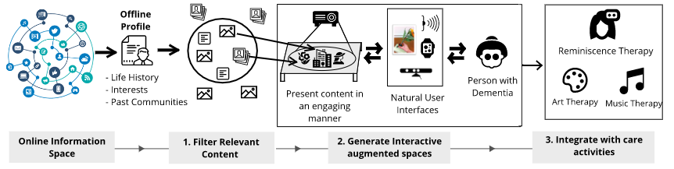
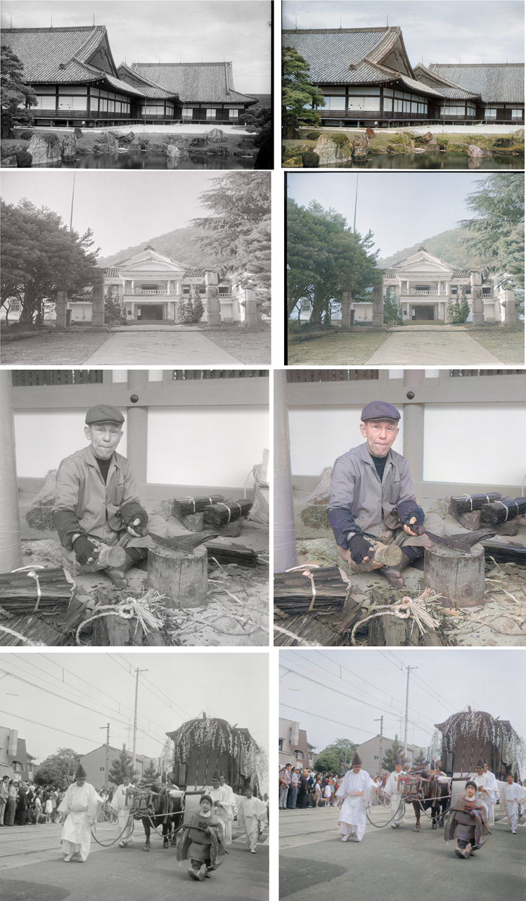
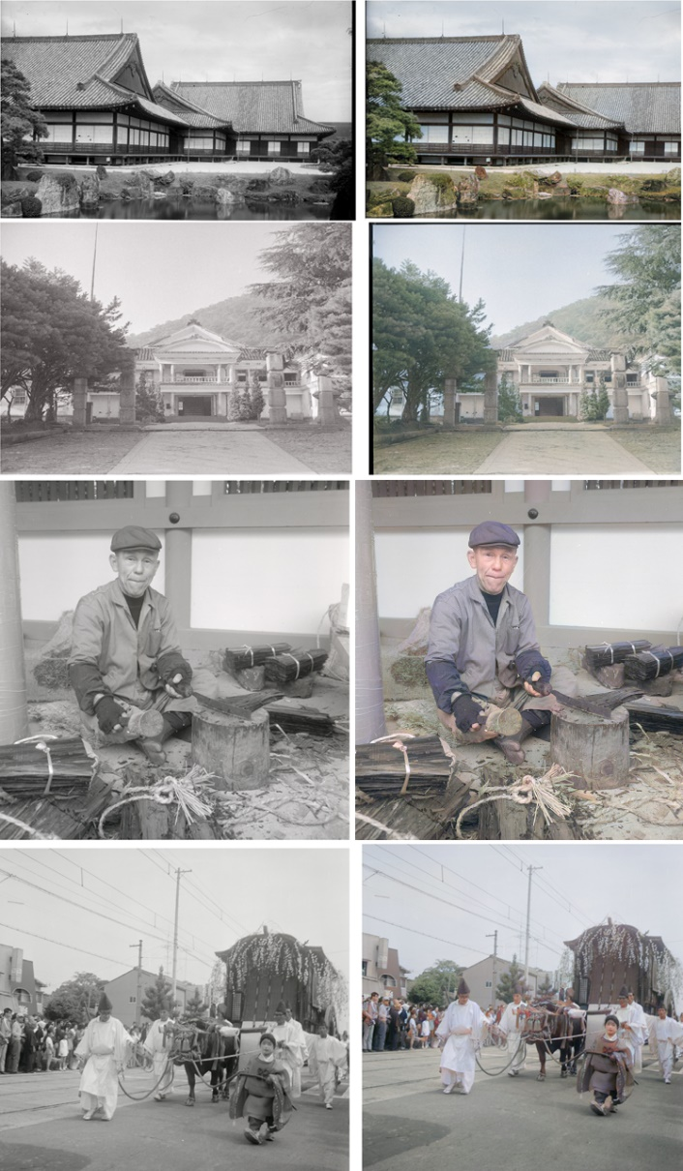
reminiscence THERAPY FOR DEMENTIA
Develop a context aware filtering algorithm to automatically extract information (text and pictures etc.) from social media images and use them in Reminiscence therapy

